Slide 1
IRS Form 1040
2019 Proposed Revisions

Slide 2
1040 TY 2018 vs 2019 for Training
There was a drastic change in the IRS 1040 between TY 2017 and TY 2018.
The TR2018 form was difficult to follow and hard to explain to a taxpayer
The IRS has proposed a revised 1040 for TY 2019 (still in draft mode) that has several improvements
Since we will be using TY2018 TaxSlayer software for training, the forms generated will differ from the actual 2019 forms

Slide 3
Goal
The goal of this training is to familiarize the student with the 2018/2019 format and flow using the TY 2019 proposed form

Slide 4
IRS Form 1040
The 2019 simplified 1040 covers:
Taxpayer information & Signature
Income
Deductions
Taxes & Credits
Payments/Refunds Due and Signature
Although the format is similar to 2018, there are some proposed improvements for 2019

Slide 5
Schedules
In 2018 there were five schedules associated with the 1040. In 2019 the five schedules were reduced to three by putting some of the information from the schedules into the 1040 and combining some of the schedules.

Slide 6
1040 Schedules
The schedules associated with the 1040 make the 1040 as complete as was the 2017 version. The three basic schedules that we will see are:
Schedule 1 – Additional Income & Adjustments to Income
Line numbers have changed from 2018 version
Schedule 2 – Additional Taxes
Additional taxes from the 2018 Schedule 4 were added and line numbers changed
Schedule 3 – Additional Credits and Payments
Other Payments and Refundable Credits from the 2018 Schedule 5 were added and line numbers changed

Slide 7
1040 Page 1 Taxpayer Information
Includes:
Filing status
Personal information for taxpayer & spouse
Spouse Standard Deduction Information
Full year health coverage check box removed in 2019
Presidential election campaign question
Dependent information
Most of this information comes from the “Personal Information” section of TaxSlayer

Slide 8
Form 1040 Page 1 Taxpayer Info
Personal Information

Slide 9
Form 1040 Page 1 Taxpayer Info
Presidential Election Campaign Fund

Slide 10
Form 1040 Page 1 Taxpayer Info
Filing Status

Slide 11
Form 1040 Page 1 Taxpayer Info
Dependents

Slide 12
Form 1040 Page 1 Taxpayer Info
Standard Deduction and Age/Blindness

Slide 13
Income(Page 2 for 2018, Page 1 for 2019)
Wages, interest, dividends, retirement, social security and capital gains (for 2019) are entered on the form. Schedule 1 other income is carried to line 7 for 2018 or line 7a for 2019.
For 2019 retirement is split into two lines (IRA contributions and Pensions and annuities)
All of the above income is derived from various tax forms usually issued by employer, financial institution, government agency, etc
Information from tax forms and client interview are entered into the TaxSlayer input screens
TaxSlayer puts the appropriate values into the 1040 and Schedule 1
Adjustments to income from Schedule 1 are subtracted from total income line 6 to calculate Adjusted Gross Income.
“Adjusted Gross Income” (line 7 for 2018 and line 8b for 2019)
The standard or itemized deduction is subtracted from the AGI to get taxable income

Slide 14
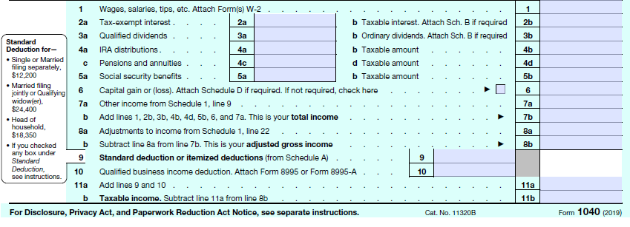
1040 Page 1 Income
Income

Slide 15
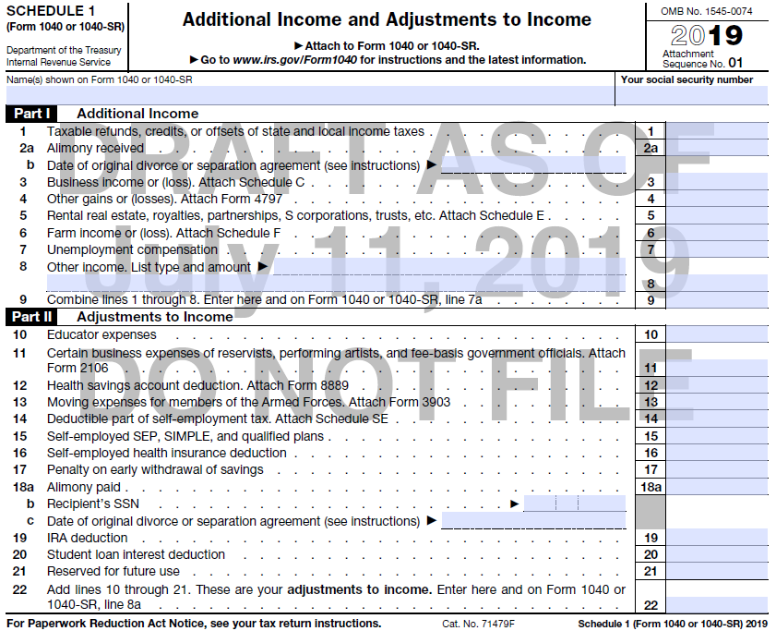
Schedule 1 Additional Income

Slide 16
1040 Page 1 Calculations
Calculations to arrive at Taxable Income

Slide 17
Schedule 1 Adjustments

Slide 18
Taxes & Credits (TY 2019 1040 Page 2)
Total Tax
Start with Calculated Tax on Taxable Income
Add other tax from Schedule 2
Deduct credits (non-refundable) and other credits
Add other taxes due from schedule 2
Deduct refundable credits from schedule 3
Bottom line is the amount to be refunded or the amount owed.
Bank information for direct deposit or refund shown here
Notes:
Discuss the difference between refundable and nonrefundable credits

Slide 19
1040 Page 2
Tax to amount owed/refund calculation

Slide 20
1040 Schedule 2

Slide 21
1040 Schedule 3

Slide 22
1040 Page 2 Bottom of Form
Third party designee (Out of scope for us)
Signature box
Includes IRS identity pins (if required)
Paid preparer information ( AARP Site Identification number)

Slide 23
1040 Page 2
Third Party Designee (Out of Scope)

Slide 24
1040 Page 2
Signature Box

